Slide 1

CS-0401
INTERMEDIATE PROGRAMMING
USING JAVA
Prof. Dr. Paulo Brasko Ferreira
Spring 2018

Slide 2
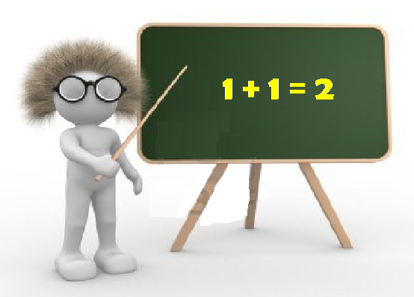
Chapter 2
Java Fundamentals

Slide 3
Chapter 2 Presentation Outline
  Parts of a program
  Variables, methods, and classes
    Naming convention
  Data types: Primitive versus class types
  Arithmetic Operators
  The Math Class
  Conversion between primitive data types
  Creating constants with the final keyword

Slide 4
Chapter 2 Presentation Outline (cont.)
  The String class
  Variable Scope
  Comments
  Programming style
  Reading from the keyboard
  Dialog boxes

Slide 5
Parts of a program

Slide 6
Parts of a program
// This is a simple Java program
public class Payroll {
public static void main(String[] args) {
int hours = 40;
double grossPay, payRate = 25.0;
// calculate the income
grossPay = hours *
payRate;
System.out.println(“Your gross pay is $” +
grossPay);
}
}
Comment line
Class body
Method type modifier
End of a Statement
Class Header
Method Header
Method return type
Blank lines
Class definition
Method name
General statements
Access specifier
Method Arguments
Block characters
Class name
Method access specif.
General Print Statmnt

Slide 7
Identifiers for Variables,
Methods, and Classes

Slide 8

Java Identifiers
Identifiers are the names of the variables, methods, classes, packages, and interfaces
Identifier Rules:
Must be composed of:
  letters
  numbers
  underscore _
  dollar sign $
Identifiers may only begin with:
  a letter
  the underscore
  dollar sign

Slide 9
Examples of Identifiers
Valid Identifiers:
MyVariable
myvariable
MYVARIABLE
x
i
_myvariable
$myvariable
_9pins
andros
ανδρος
Oreilly
Invalid Identifiers:
My Variable
9pins
a+c
testing1-2-3
O'Reilly
OReilly_&_Associates

Slide 10

Naming Conventions

Slide 11
Naming Convention
Class names always start with upper case letters and the rest in lower case:
  Example: public class Bicycle
Method names always start with lower case letters
  Example: private void evaluate()
Variable names always start with lower case:
  Example: int number = 10;

Slide 12
Naming Convention (continuation)
Names that contain two or more words, we capitalize the initial of the words as follows:
  For classes: public class RacingBikes
  For methods: private void calculateAnnualTax()
  For variables: int numberOfKeys = 10;
See PayrollDialog.java

Slide 13
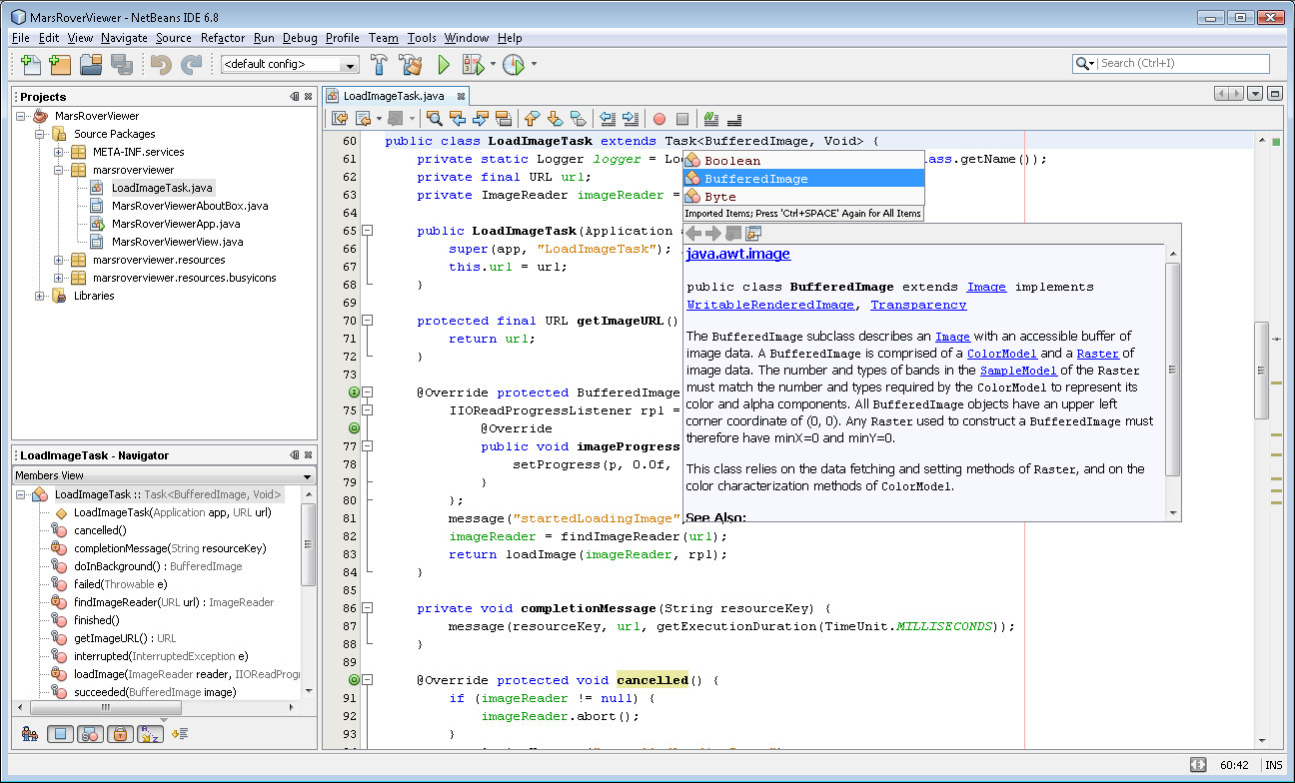

Slide 14
Java Literals

Slide 15
Java Literals
Literals are constant values in a program. Literals represent numerical (integer or floating-point), character, boolean or string values.
Integer literals:
0 -9
Floating-point literals:
.3 0.3 3.14
Character literals:
'(' 'R' 'r' '{‘
Boolean literals:
true false
String literals:
"language" "0.2" "r" ""

Slide 16
Data types

Slide 17

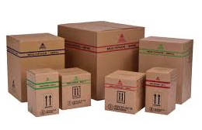

Variables and data types
What is the following command telling us ???
int weekDays = 7;
7
weekDays
Besides “int”, what other “primitive” data types are available in Java?

Slide 18
Primitive data types
byte: The byte data type is an 8-bit signed integer. It has a minimum value of -128 and a maximum value of 127 (inclusive).
short: The short data type is a 16-bit signed integer. It has a minimum value of -32,768 and a maximum value of 32,767 (inclusive).
int: The int data type is a 32-bit signed integer. It has a minimum value of -2,147,483,648 and a maximum value of 2,147,483,647 (inclusive).
long: The long data type is a 64-bit signed. It has a minimum value of -9,223,372,036,854,775,808 and a maximum value of 9,223,372,036,854,775,807 (inclusive).

Slide 19
Variables and primitive data types
float: The float data type is a single-precision 32-bit IEEE 754 floating point.
double: The double data type is a double-precision 64-bit IEEE 754 floating point.
boolean: The boolean data type has only two possible values: true and false.
char: The char data type is a single 16-bit Unicode character

Slide 20
Examples
See IntegerVariables.java
See Letters.java
See Letters2.java
See Sale.java
See StringDemo.java
See StringLength.java

Slide 21
Conversion between
Data Types

Slide 22
Be careful when handling variables of different types
Small types can fit on bigger types
  Example: int a = 10; double b; b = a;
Big types do not fit in small variables
  Example: double b = 10.5; int a; a = b;
However, sometimes we can make it fit!
  We can use casting to fit one big value into a small variable
  Example: double b = 10.9; int a; a = (int) b;
See Variable.java

Slide 23

An alternative ending for Cinderella story…
Now that I am using the Java casting feature, her shoes fit like a glove…

Slide 24

Why don’t we always use Double instead of byte, short, int, and float and stop worrying about how big the number can be inside them?

Slide 25
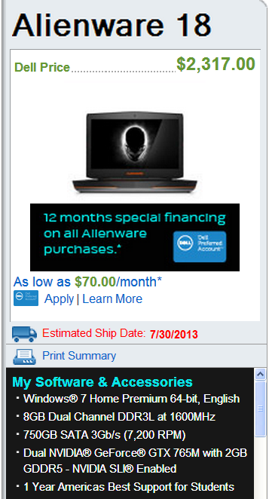

There is always a limit of how much memory a laptop, cell phone, coffee maker has.

Slide 26
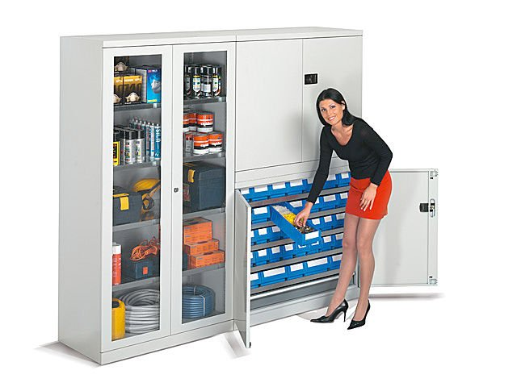
Why don’t we define all numerical variables as double ?
And I though that I was going to do a Kitchen advertisement…

Slide 27

Data Transfer over the internet
Another problem in having all variables defined as double:
Your program can become large in size and the bigger your program is the more it takes to be downloaded/transferred over the internet

Slide 28

Why we keep talking about “primitive” data types?
Is there other types out there?

Slide 29
Primitive data types
Primitive data types:
  All the ones discussed so far (double, int, float, boolean, etc.)
Class data type:
  An object from a given class

Slide 30
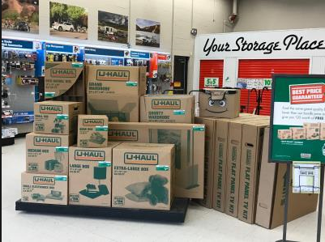




Example
7
weekDays

Slide 31

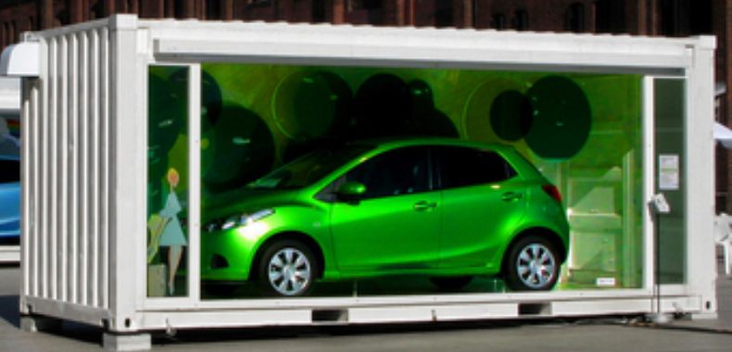


Can I get a box for my car in a U-Hall Store?
The car is not in the box
The key is just a reference. The car is outside the house

Slide 32



A reference to where the elephant object is placed in the memory
(0x12EF05)
Modify Simple.java
long

Slide 33
Primitive Types: their values are placed right into the allocated memory
Object Types: the allocated memory (variable) contains a reference to what object is and where the object is placed in memory
This difference has some implications on how these two types of variables are treated in Java (e.g., method arguments)

Slide 34
Arithmetic Operators

Slide 35
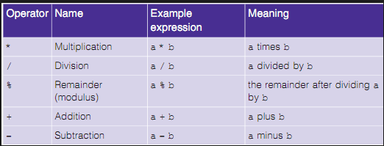
Arithmetic Operators

Slide 36
Important Notes on Operators
Dividing an integer number by another integer number will result in an integer value
  Example: 3/2 ➔ 1 (not 1.5 as one would expect)
The modulus and integer division can be very useful
  Example: compute how many hours, minutes, and seconds are in 12340 seconds
Let’s try some examples…

Slide 37
Operators Precedence in Java Language

Slide 38
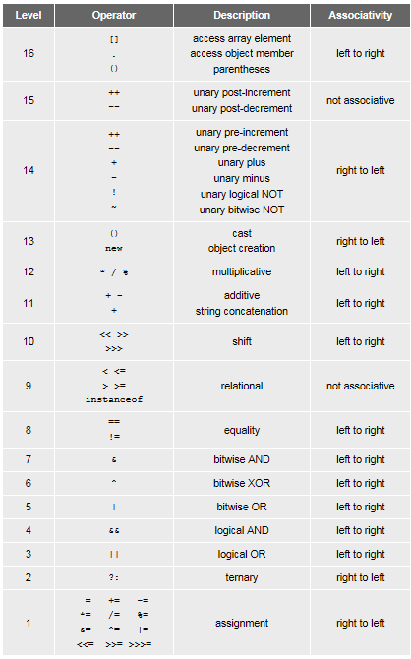
Most programmers do not memorize them all, and even those that do still use parentheses for clarity

Slide 39

The Java API

Slide 40
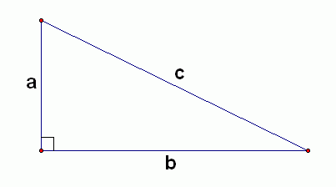
An Example of Using the API
Let’s make a Java code that computes the length of a hypotenuse (side “c”) of a right angle triangle, based on the triangle sides “a” and “b”
What is the equation to compute c?

Slide 41
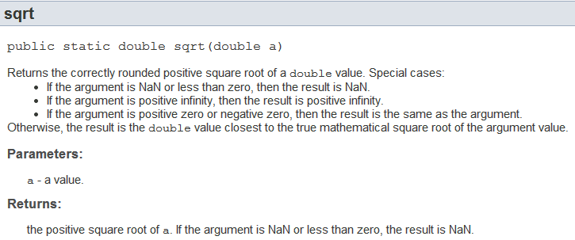
Java Math Class
In a web browser, search for Java API Math:
Let’s understand what the documentation is telling us about the methods input arguments and returning values

Slide 42
The Program Source Code
import java.lang.*;
public class HypotenuseCalculator {
public static void main(String[] args) {
double a = 3;
double b = 4;
double c;
// one way of doing the calculation…
double term1 = Math.pow(a,2);
double term2 = Math.pow(b,2);
double sumOfTerms = term1 + term2;
c = Math.sqrt(sumOfTerms);
// another way of doing the calculation…
c = Math.sqrt( Math.pow(a,2) + Math.pow(b,2));
System.out.println(c);
}
}
See HypotenuseCalculator.java

Slide 43
Important Note
Using the Math class, casting a float/double number into an integer, and using integer division can be used to round numbers
Let’s discuss these examples in class

Slide 44
The String Class

Slide 45
The String Class
// A simple program demonstrating String objects.
public class StringDemo {
public static void main(String[] args) {
String greeting = "Good morning ";
String name = "Herman";
System.out.println(greeting + name);
}
}

Slide 46
// This program demonstrates a few of the String methods.
public class StringMethods {
public static void main(String[] args) {
String message = "Java is Great Fun!";
String upper = message.toUpperCase();
String lower = message.toLowerCase();
char letter = message.charAt(2);
int stringSize = message.length();
System.out.println(message);
System.out.println(upper);
System.out.println(lower);
System.out.println(letter);
System.out.println(stringSize);
}
}
See StringMethods.java

Slide 47

Scope

Slide 48
Scope
public class Scope {
public static void main(String[] args) {
int x; // known to all code withing the main
x = 10;
if (x == 10) {
int y = 20; // known only to this IF block
System.out.println("The value of x is: " + x
+ " the value of y is: " + y);
}
System.out.println("The value of x is: " + x );
System.out.println("The value of y is: " + y );
}
}
See Scope.java

Slide 49
Comments

Slide 50
Comments
There are 3 types of comments in java.
Single Line Comment
  // this method computes the average value
Multi Line Comment
  /*
  This method computes the minimum
  value between the coefficient A and B
  */
Documentation Comment
  /**
  This method computes the average value
  */
  http://www.oracle.com/technetwork/articles/java/index-137868.html

Slide 51

Programming Style
(aka “Java Coding Standards”)

Slide 52
Programming Style
public class Compact {public static void main(String[] args) {int shares=220;double averagePrice=14.67;System.out.println ("There were "+shares+" shares sold at $"+averagePrice+
" per share.");}}
public class Compact {
public static void main(String[] args) {
int shares=220;
double averagePrice=14.67;
System.out.println("There were "+shares+" shares “ +
“sold at“ + averagePrice + “per share.");
}
}
See Compact.java

Slide 53

Java Coding Standards
Each line contains at most one simple statement
Adhere to Naming Conventions (CamelCaseNames)
No instance or class variables may be public
Numerical constants (literals) should not be coded directly (i.e. avoid “magic numbers”)
Don't assign several variables to the same value in a single statement
Never use break or continue in a loop or decision
Never compare a boolean value (or boolean function call) to a boolean constant
Remove unused variables
Delete commented statements when possible
http://users.csc.calpoly.edu/~jdalbey/SWE/CodeStdCheck.html
You MUST follow these rules! There will be a checklist for you to fill in for every single assignment and lab! The TA will grade your work on this too!
See Readable.java

Slide 54
Ways of entering data into your program

Slide 55
Ways of entering data into your program
How did we enter the sides of the triangle in our Pythagoras program?

Slide 56
import java.lang.*;
public class PythagoreanTheorem
{
public static void main(String[] args)
{
double a = 3;
double b = 4;
double c;
c = Math.sqrt(Math.pow(a,2)+Math.pow(b,2));
System.out.println(c);
}
}
This is what we call “hard-coded” values
Is there any other way to input data?

Slide 57
Ways of entering data into your program
Dialog Boxes
Main(String[] args)
File Input
Keyboard
Hard-coded
Specialized hardware (Bluetooth, sensors, etc.)

Slide 58

Hard-coded input

Slide 59
Hard-coded inputs
import java.lang.*;
public class PythagoreanTheorem
{
public static void main(String[] args)
{
double a = 3;
double b = 4;
double c;
c = Math.sqrt(Math.pow(a,2)+Math.pow(b,2));
System.out.println(c);
}
}
Good or bad?
Math.PI

Slide 60
The main(String[] args)

Slide 61

The main(String[] args)
public static void main(String[] args)
{
double a = Double.parseDouble(args[0]);
double b = Double.parseDouble(args[1]);
double c = Math.sqrt(Math.pow(a,2) +
Math.pow(b,2));
System.out.println("Value of c: " + c);
}
What does “args” stand for?
But what arguments???

Slide 62
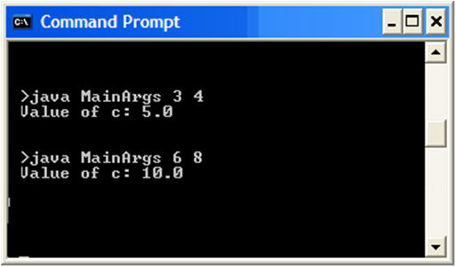
The main(String[] args)
Arguments from the command line

Slide 63

Converting a String to a Number
public static void main(String[] args)
{
double a = Double.parseDouble(args[0]);
double b = Double.parseDouble(args[1]);
double c = Math.sqrt(Math.pow(a,2) +
Math.pow(b,2));
System.out.println("Value of c: " + c);
}
Numbers are not Strings! Is it a problem?
The args are arrays of Strings

Slide 64


This is John!
You can chat and interact
with this person
This is John’s picture!
You cannot chat with it!
Even though they look the same, they are two different things! You cannot interact with John’s picture as you would with the actual John!

Slide 65
The Parse Methods
  // Store 1 in bVar.
  byte bVar = Byte.parseByte("1");
  // Store 2599 in iVar.
  int iVar = Integer.parseInt("2599");
  // Store 10 in sVar.
  short sVar = Short.parseShort("10");
  // Store 15908 in lVar.
  long lVar = Long.parseLong("15908");
  // Store 12.3 in fVar.
  float fVar = Float.parseFloat("12.3");
  // Store 7945.6 in dVar.
  double dVar = Double.parseDouble("7945.6");

Slide 66


Getting data from a text file

Slide 67
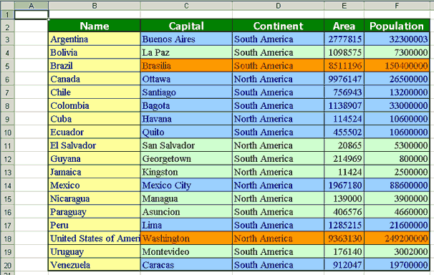
Getting data from a text file
Your program must process this data
This data is saved in a text file
There are 1000 lines to process
It is inefficient to type them in the command line!

Slide 68
Getting data from a text file
BufferedReader reader = new BufferedReader(new FileReader("/path/to/file.txt"));
String line = null;
while ((line = reader.readLine()) != null)
{
// ...
}

Slide 69

Getting Data
From Terminal Window

Slide 70
The Scanner Class
To read input from the keyboard we can use the Scanner class.
The Scanner class is defined in java.util, so we will use the following statement at the top of our programs:
import java.util.Scanner;

Slide 71
The Scanner Class
Scanner objects work with System.in
To create a Scanner object:
Scanner keyboard = new Scanner(System.in);
See example: Payroll2.java

Slide 72
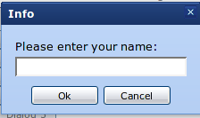
Input Data Using
Dialog Boxes

Slide 73
Dialog Boxes
A dialog box is a small graphical window that displays a message to the user or requests input.
A variety of dialog boxes can be displayed using the JOptionPane class.
The JOptionPane class provides methods to display each type of dialog box.

Slide 74
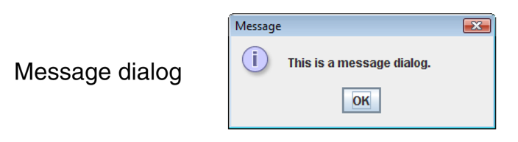
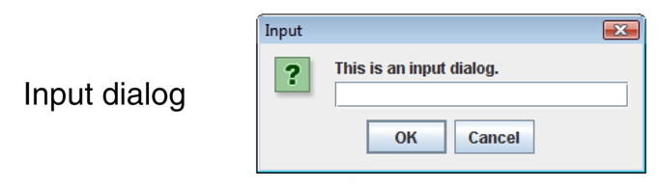
The JOptionPane Class

Slide 75
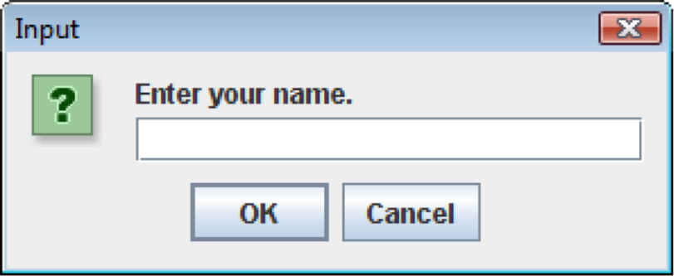
Input Dialogs
  String name;
  name = JOptionPane.showInputDialog("Enter your name.");
The argument passed to the method is the message to display.
If the user clicks on the OK button, name references the string entered by the user.
If the user clicks on the Cancel button, name references null.

Slide 76
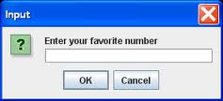
Converting a String to a Number
Similarly, a String representing a number is NOT the same as a number!
You cannot do math operations on a “picture” of a number
You MUST convert the String representation to an actual number!
See example: PayrollDialog.java

Slide 77

Any Questions?

